Slide 1
Job Management in Alma
Yoel Kortick
Senior Librarian

Slide 2

Agenda
Types of Jobs
Scheduled Jobs
Scheduled Jobs from Fulfillment Jobs Configuration
Scheduled Jobs from Profiles
Workflow Jobs
Manual Jobs
Export jobs and viewing exported files
The Scheduled Jobs Status Widget
Email Notifications and the System Job Letter
APIs

Slide 3
Types of jobs

Slide 4
Types of Jobs
There are three types of jobs in Alma:
  Scheduled jobs
  Workflow jobs
  Manual jobs

Slide 5
Scheduled Jobs

Slide 6
Scheduled Jobs
Scheduled jobs
  Scheduled jobs run periodically via a schedule.
  Some of these jobs are scheduled by Alma. For other jobs the schedule can be configured using predefined job scheduling options.
  Scheduled jobs run as close as possible to their scheduled time, depending on system resources and processes. Some jobs can run in parallel, but part or all of a job may wait until a server has available resources.

Slide 7
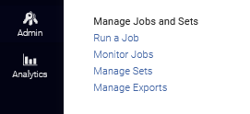
Scheduled Jobs
Let’s go take a look at some scheduled jobs.
We can view the scheduled jobs at “Alma Menu > Admin > Manage Jobs and Sets > Monitor Jobs”

Slide 8
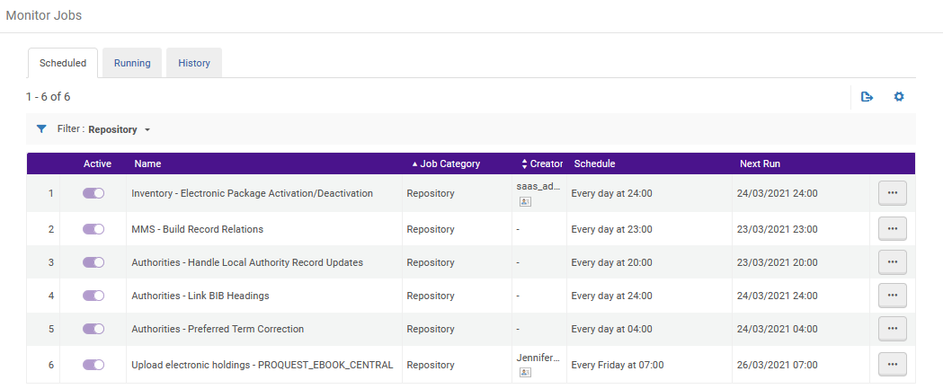
Scheduled Jobs
Examples of Scheduled jobs
Jobs which are currently running, or have run and completed, can be viewed via the “Running” and “History” tabs.

Slide 9
Scheduled Jobs from Fulfillment Jobs Configuration

Slide 10
Scheduled Jobs from Fulfillment Jobs Configuration
Some scheduled jobs, such as “MMS – Build Record Relations” and “Authorities – Link Bib Headings” work without any specific parameters provided by the institution.
Other scheduled jobs, such as “Notices - Send Courtesy Notices and Handle Loan Renewals” and “Send Hold Shelf Reminders” do require parameters provided by the institution.
  We will now take a look at the configuration of these two scheduled fulfillment jobs as an example.

Slide 11
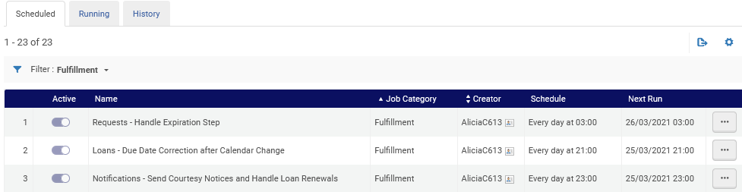
Scheduled Jobs from Fulfillment Jobs Configuration
Here we see that the jobs “Notices - Send Courtesy Notices and Handle Loan Renewals” and “Send Hold Shelf Reminders” are scheduled
Here we are at “Alma Menu > Admin > Manage Jobs and Sets > Monitor Jobs”

Slide 12
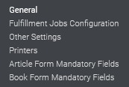
Scheduled Jobs from Fulfillment Jobs Configuration
The institution configures the jobs “Notices - Send Courtesy Notices and Handle Loan Renewals” and “Send Hold Shelf Reminders” at “Configuration menu > Fulfillment > General > Fulfillment Jobs Configuration”

Slide 13
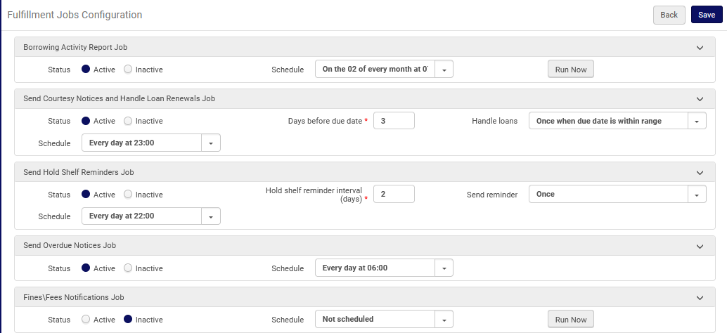
Scheduled Jobs from Fulfillment Jobs Configuration
We will see a close-up of these two jobs on the next slide.

Slide 14
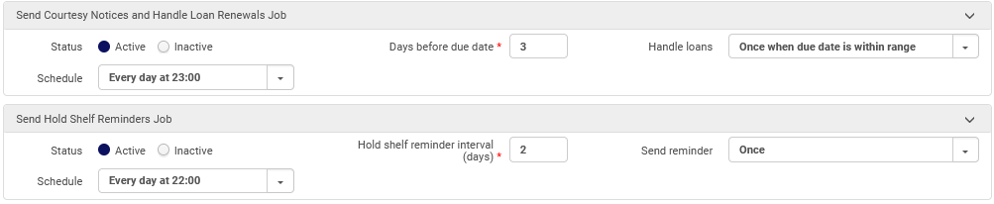
Scheduled Jobs from Fulfillment Jobs Configuration
Examples of parameters for the institution to configure for the jobs.
Scheduled run time
Job configurations

Slide 15
Scheduled Jobs from Profiles

Slide 16
Scheduled Jobs from Profiles
Other scheduled jobs also take parameters from the institution's configurations.
These include scheduled jobs originating from the following profiles:
Integration Profiles
Import Profiles
Publishing Profiles

Slide 17
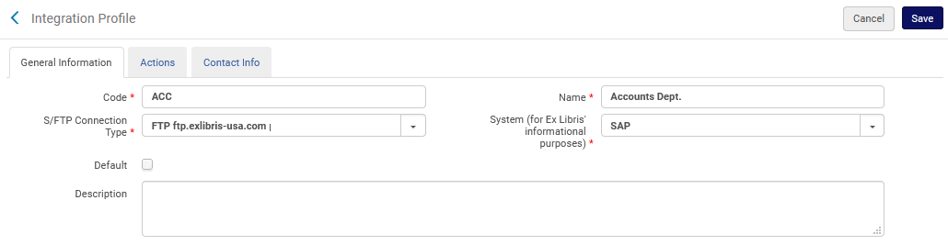
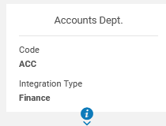
Scheduled Jobs from Profiles
For example, here we have an integration profile named “Accounts Dept”
Integration type is “Finance”

Slide 18
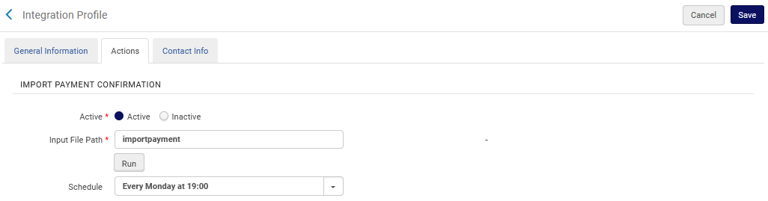
Scheduled Jobs from Profiles
It is scheduled to run an import every Monday at 19:00

Slide 19
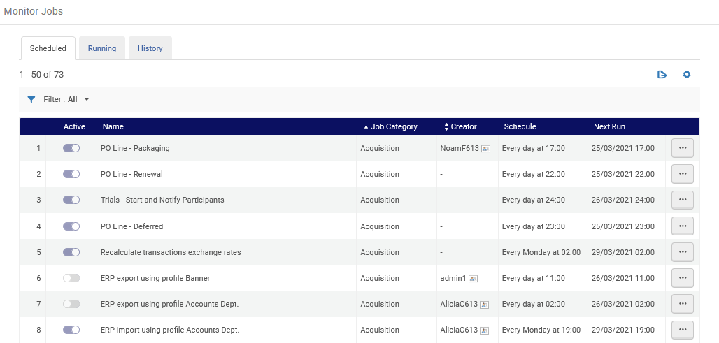
Scheduled Jobs from Profiles
Here is the corresponding scheduled job
Here we are at “Alma Menu > Admin > Manage Jobs and Sets > Monitor Jobs”

Slide 20
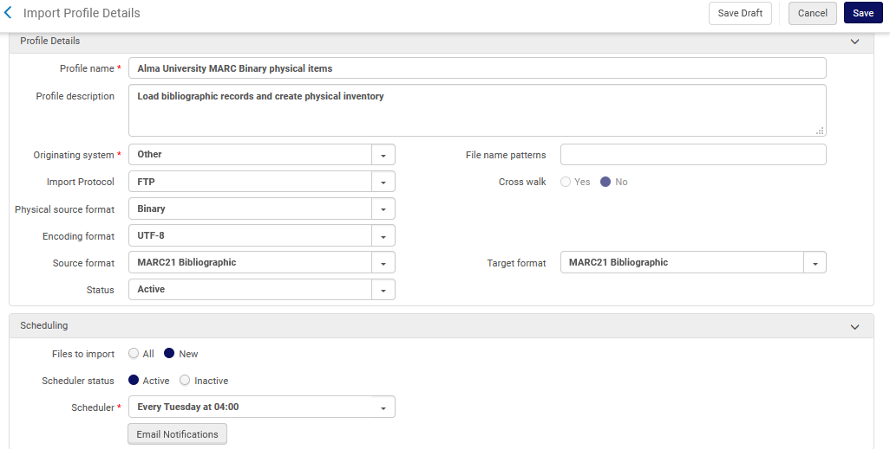
Scheduled Jobs from Profiles
For example, here we have an import profile named “Alma University MARC Binary physical items”
It is scheduled to run every Tuesday at 04:00

Slide 21
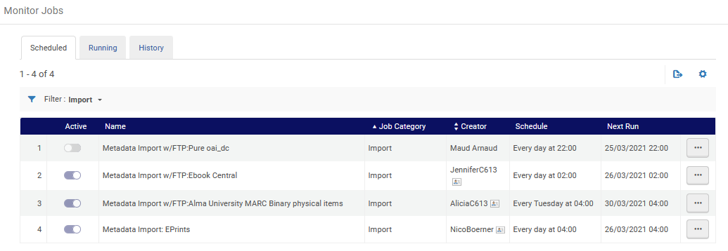
Scheduled Jobs from Profiles
Here is the corresponding scheduled job
Here we are at “Alma Menu > Admin > Manage Jobs and Sets > Monitor Jobs”

Slide 22
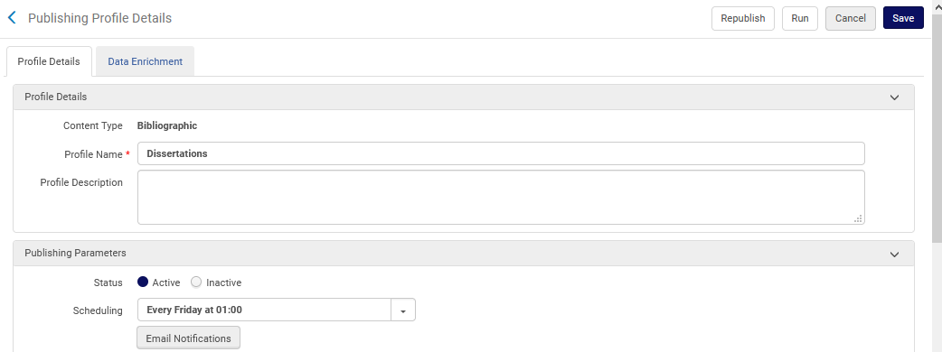
Scheduled Jobs from Profiles
For example, here we have a publishing profile named “Dissertations”.
It is scheduled to run every Friday at 01:00

Slide 23
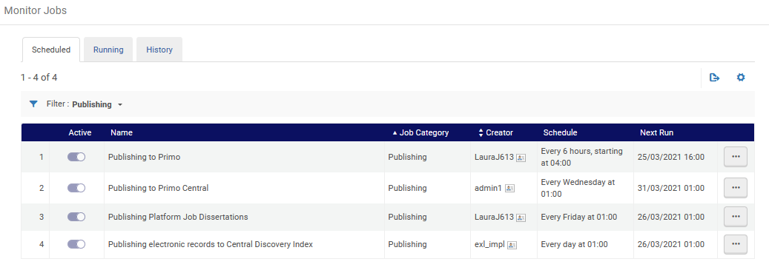
Scheduled Jobs from Profiles
Here is the corresponding scheduled job
Here we are at “Alma Menu > Admin > Manage Jobs and Sets > Monitor Jobs”

Slide 24
Workflow Jobs

Slide 25
Workflow Jobs
Workflow jobs
  Workflow jobs run automatically when they are required.
  For example:
  After submitting a purchase order, the job “Export Orders (PO) Job” runs.
  After filtering a set, the job “Filter set by indication” runs.

Slide 26
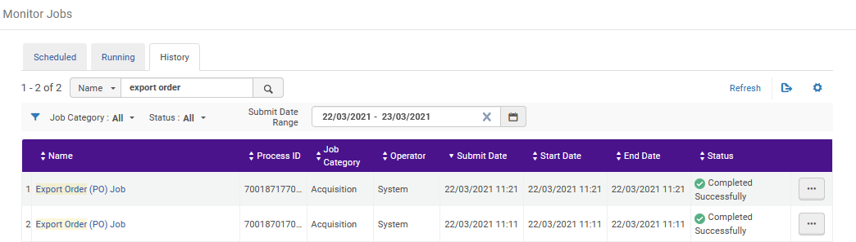
Workflow Jobs
Examples of workflow jobs

Slide 27
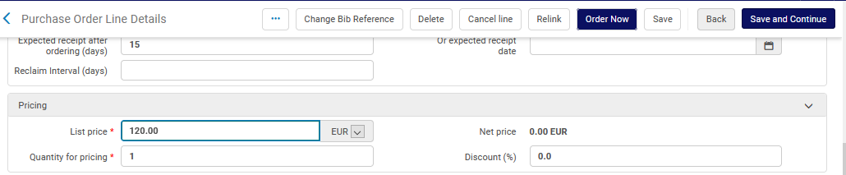
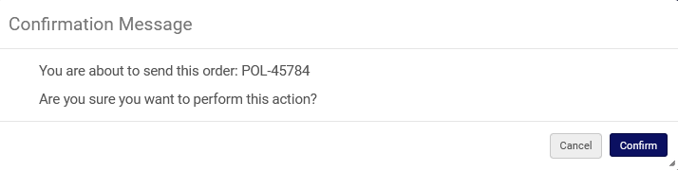
Workflow Jobs
An order (POL) is sent

Slide 28
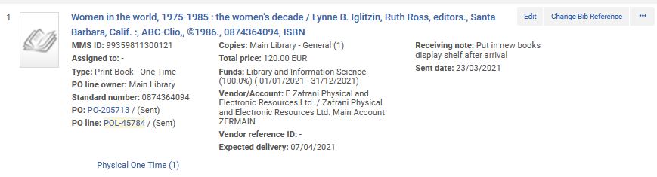
Workflow Jobs
A Purchase Order (PO) is created

Slide 29
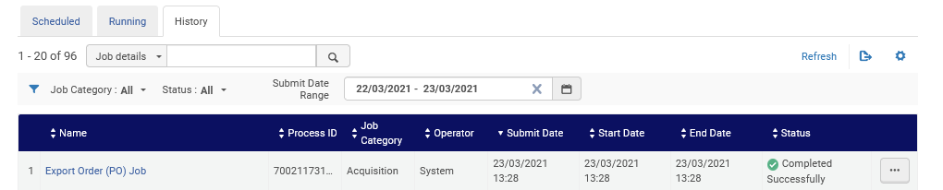
Workflow Jobs
The Purchase Order (PO) was created from the job “Export Order (PO) Job
Here we are at “Alma Menu > Admin > Manage Jobs and Sets > Monitor Jobs”

Slide 30
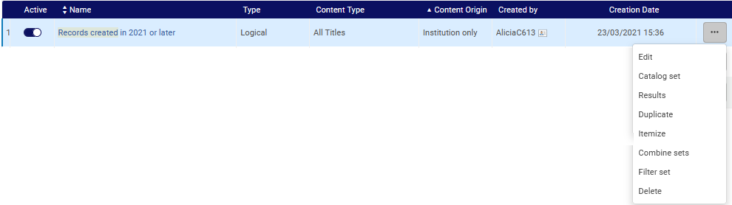
Workflow Jobs
Another example of creating a “workflow job” is submitting the filtering of a set

Slide 31
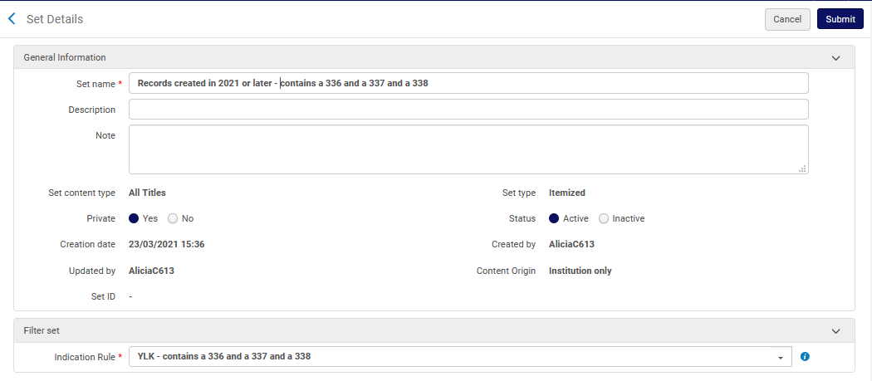
Workflow Jobs
Clicking “Submit” will send a “workflow job”.

Slide 32
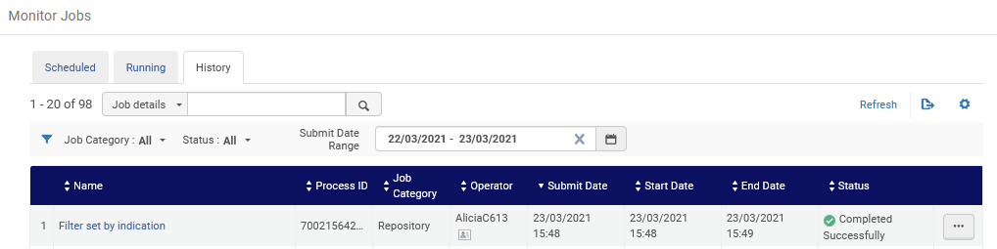
Workflow Jobs
A workflow job called “Filter set by indication” runs
Here we are at “Alma Menu > Admin > Manage Jobs and Sets > Monitor Jobs”

Slide 33
Manual Jobs

Slide 34
Manual Jobs
Manual jobs are available to run as required.
Some manual jobs require prerequisite activities, such as creating a normalization process or a set.
In these cases, the jobs run using the normalization process and / or the set.

Slide 35
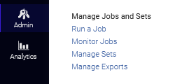
Manual Jobs
Manual jobs can be run from “Alma Menu > Admin > Manage Jobs and Sets > Run a Job”

Slide 36
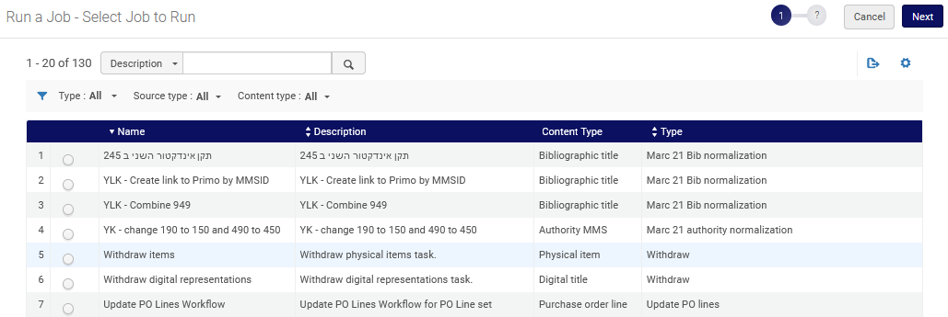
Manual Jobs
The list of possible jobs to run appears with facet and filter options

Slide 37
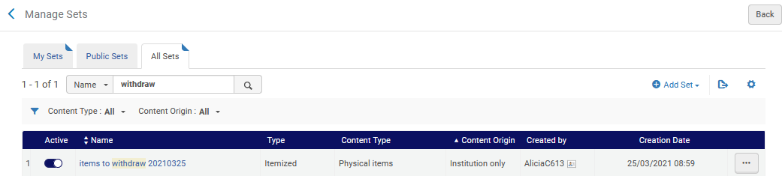
Manual Jobs
We will now do an example, and run the manual job “Withdraw Items”
It works on a set of physical items.
We have a set prepared in advanced
We will run the job on this set

Slide 38
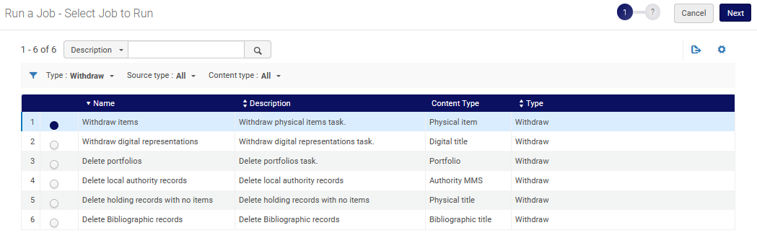
Manual Jobs
From “Alma Menu > Admin > Manage Jobs and Sets > Run a Job” we select the job.

Slide 39
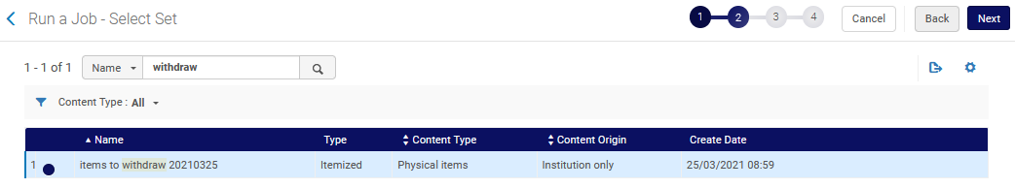
Manual Jobs
Then we select the set

Slide 40
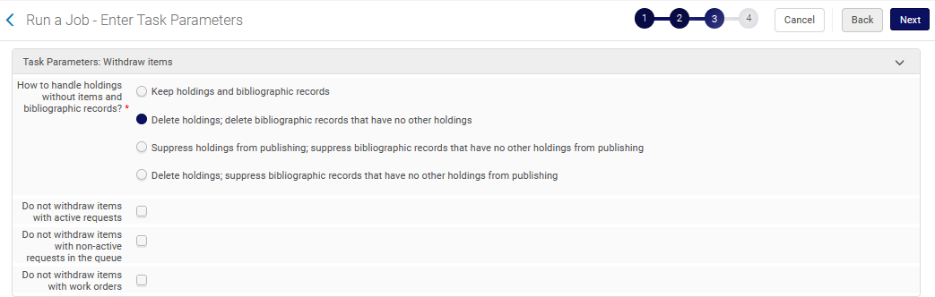
Manual Jobs
Choose desired job parameters

Slide 41
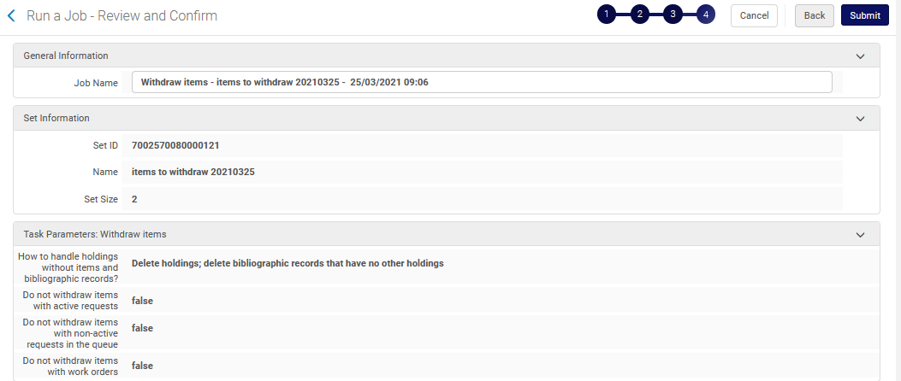
Manual Jobs
Then we submit the job

Slide 42
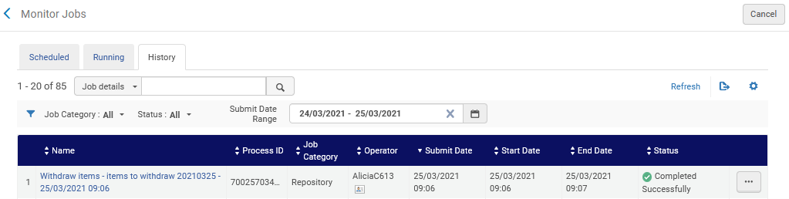

Manual Jobs
From “Monitor Jobs” was can see that the job completed

Slide 43
Manual Jobs
We will now do another example, and run the manual job “Remove 650 with 2nd indicator 7”
This is a job of type Marc 21 Bib normalization
“Remove 650 with 2nd indicator 7” is a normalization process built by the institution.
It works on a set of bibliographic titles.
We have a set prepared in advanced

Slide 44
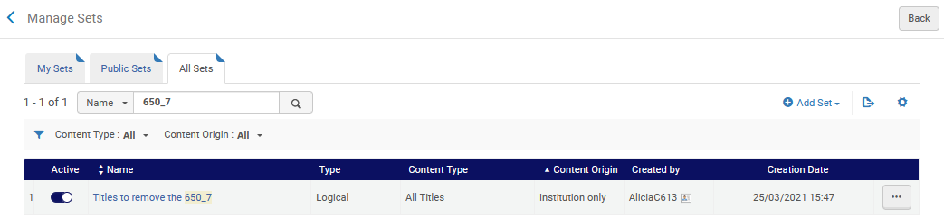
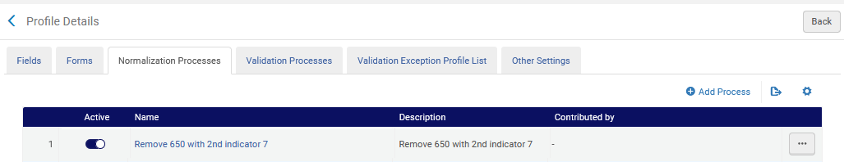
Manual Jobs
Here is the set
Here is normalization process

Slide 45
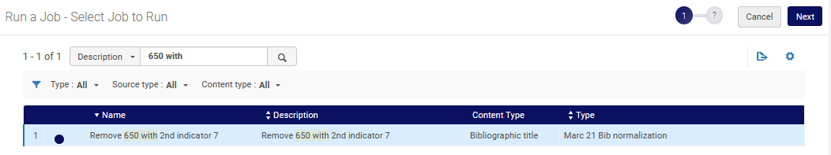
Manual Jobs
From “Alma Menu > Admin > Manage Jobs and Sets > Run a Job” we select the job.

Slide 46
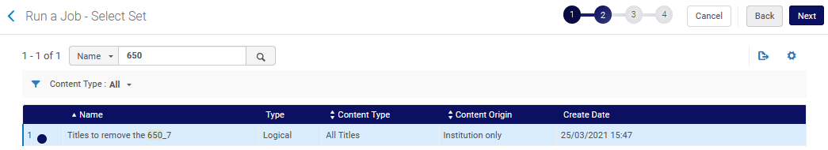
Manual Jobs
Then we select the set

Slide 47
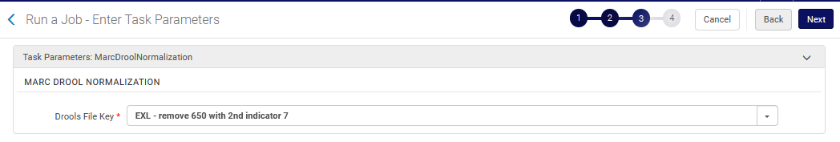
Manual Jobs
Confirm the normalization rule included in the normalization process and click ‘Next’

Slide 48
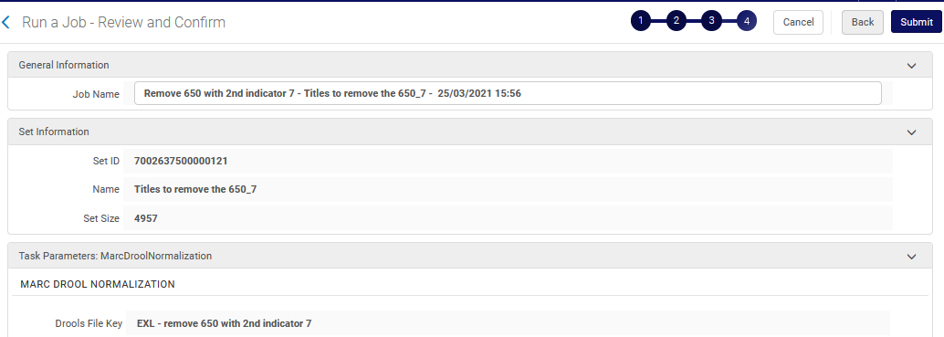
Manual Jobs
Then we submit the job

Slide 49
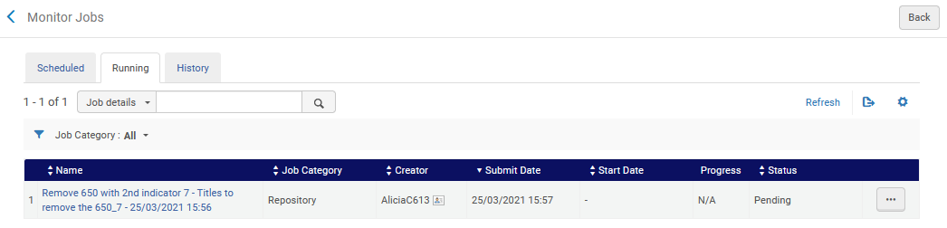
Manual Jobs
From “Monitor Jobs” was can see that the job in running

Slide 50
Export jobs and viewing exported files

Slide 51
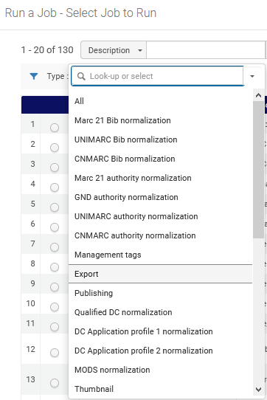
Export jobs and viewing exported files
When running a job via “Alma menu > Manage Jobs and Sets > Run a Job”, one of the job types is “Export”
Each user will see the list of job types depending on her or his roles.

Slide 52

Export jobs and viewing exported files
When running an export job the user can choose where to send the file: to a “Private” folder or an “Institution” folder.

Slide 53
Export jobs and viewing exported files
In the “Manage Exports > Private tab” the logged-in staff user can view all files that resulted from export jobs that she or he ran and marked Export folder = Private.
In the “Manage Exports > Institution tab” the logged-in staff user can view all files that resulted from export jobs run by all users and that were marked Export folder = Institution.
Note that a user with relevant roles can also access the exported file from the job report only if the export was sent to the “Institution” tab.
We will see a live example of this now.

Slide 54
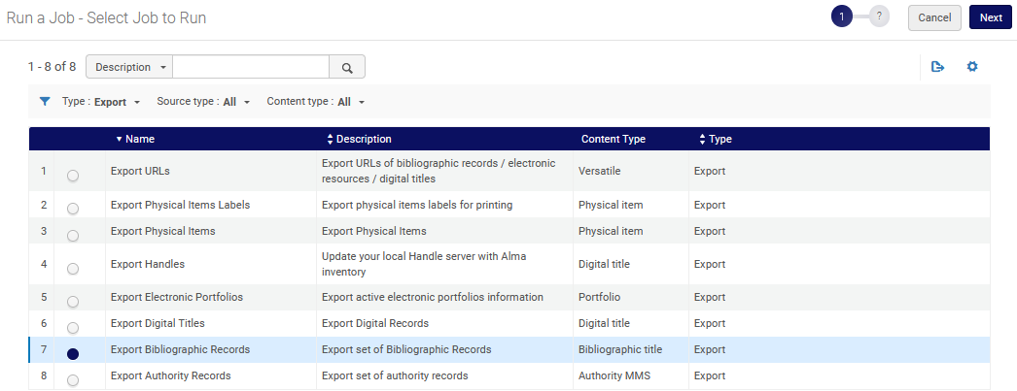
Export jobs and viewing exported files
We will run the job “Export Bibliographic Records”

Slide 55
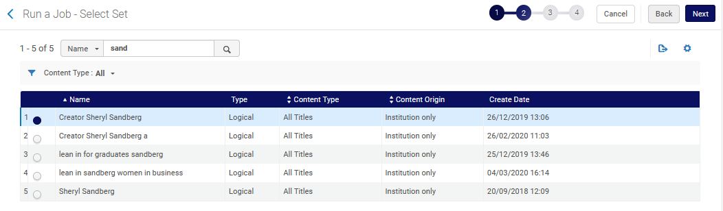
Export jobs and viewing exported files
We select the set.

Slide 56
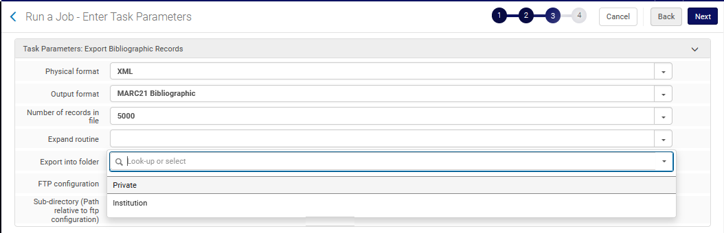
Export jobs and viewing exported files
For the “Export into folder” field we will choose “Private”.

Slide 57
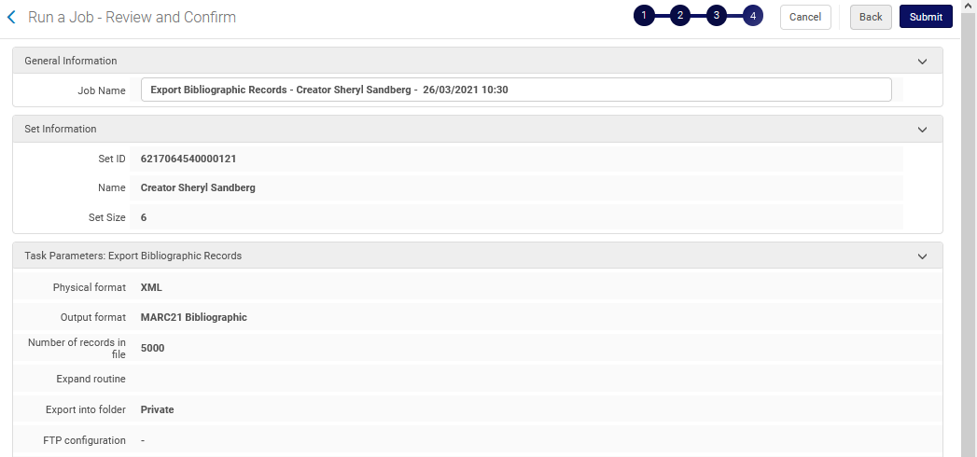
Export jobs and viewing exported files
Confirm parameters and submit

Slide 58
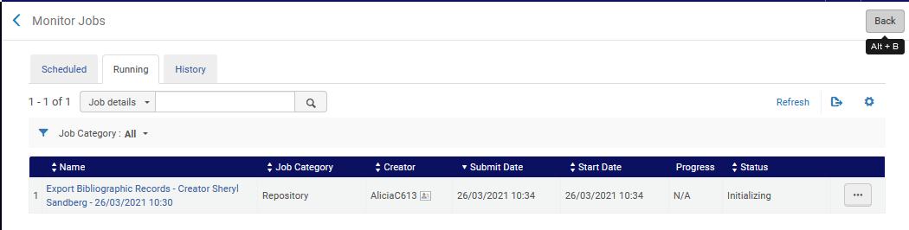
Export jobs and viewing exported files
The jobs runs

Slide 59
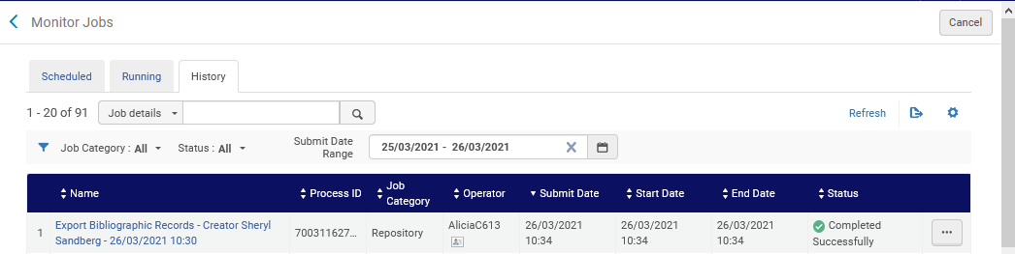
Export jobs and viewing exported files
The jobs completes

Slide 60
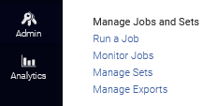
Export jobs and viewing exported files
We can download the file from “Alma Menu > Admin > Manage Jobs and Sets > Manage Exports”

Slide 61
Export jobs and viewing exported files
In the next three slides we will see as follows:
In the “Private” tab of “Manage Exports” each user sees only the files that she or he exported via a job (in the last 30 days) and chose “export into folder = Private” . Two different users can not see the other user’s exported files.
In the “Institution” tab of “Manage Exports” each user can see all files which were exported via a job (in the last 30 days) and the user chose “export into folder = Institution” . Two different users can see the list of exported files regardless of which user ran the job to create the export file.

Slide 62
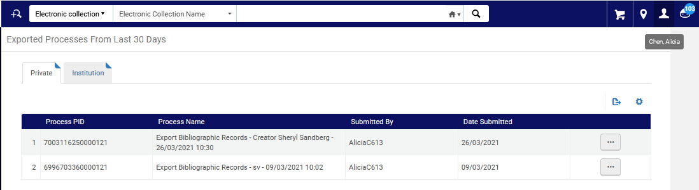
Export jobs and viewing exported files
In the “Private” tab the logged in user can see all the files she or he created from an export job which were created in the last 30 days.
When logged in as Alicia Chen this is what we see.
This is the file from the export job we ran here in this presentation.

Slide 63
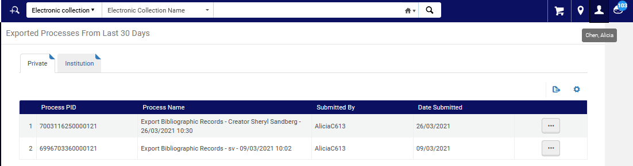
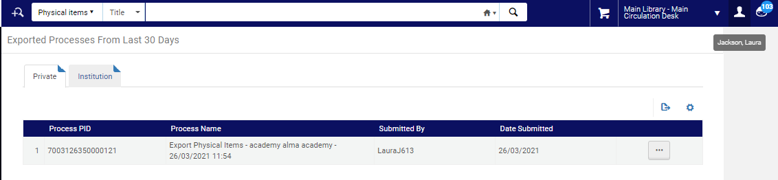
Export jobs and viewing exported files
The “Private” tab viewed by Alicia Chen
Different results for different users
The “Private” tab viewed by Laura Jackson

Slide 64
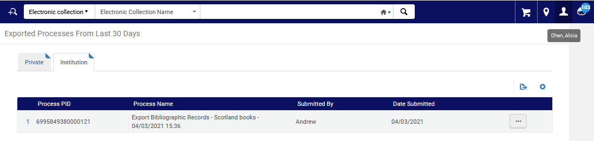
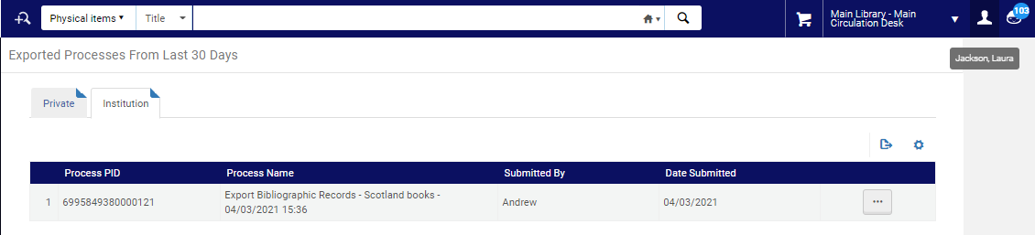
Export jobs and viewing exported files
The “Institution” tab viewed by Alicia Chen
Same results for different users
The “Institution” tab viewed by Laura Jackson

Slide 65
The Scheduled Jobs Status Widget

Slide 66
The Scheduled Jobs Status Widget
The Scheduled Jobs Status dashboard widget can be used to view an overview of the status of the recently run scheduled jobs.
Any staff user can add the widget to her or his dashboard, however she or he will only see in the widget those scheduled jobs that are relevant to her or his role.

Slide 67


The Scheduled Jobs Status Widget
Click here on top right to manage widgets

Slide 68

The Scheduled Jobs Status Widget

Slide 69

The Scheduled Jobs Status Widget
The red exclamation mark means there are jobs that failed or completed with errors
The green check mark means the jobs completed successfully

Slide 70

The Scheduled Jobs Status Widget
For example, the Acquisitions scheduled job “Trials – Start and Notify Participants” failed

Slide 71

The Scheduled Jobs Status Widget
For example, the Acquisitions scheduled job “Notify E-Activation due task” failed

Slide 72

The Scheduled Jobs Status Widget
Clicking the arrow next to the Job Category will bring the user to the jobs list
We will click here

Slide 73

The Scheduled Jobs Status Widget
We automatically arrive to the “History” tab of the “Monitor Jobs” and see the jobs that appear in the widget. From here we can further investigate via the job report.

Slide 74
Email Notifications and the System Job Letter

Slide 75
Email Notifications and the System Job Letter
It is possible to receive an email notification when scheduled jobs complete in Alma. This can be done as follows:
Go to “Alma Menu > Admin > Manage Jobs and Sets > Monitor Jobs > Scheduled Tab”.
Identify desired job > Action (...) button > select 'Email Notifications.’
The “Email Notifications for Scheduled Jobs” page appears.
In the “Subscribers by users” section add users who are registered as staff users in Alma
In the “Subscribers by Email address” section add users who are not registered as staff users in Alma
When adding a user (in either section) specify whether you want the user to receive notifications for “Send on Success” or “Send on Error” or both.

Slide 76

Email Notifications and the System Job Letter
We will add Email Notifications for job “Authorities – Preferred Term Correction

Slide 77

Email Notifications and the System Job Letter
We will now click here
In this section the staff user can add emails of users registered as staff users in Alma
In this section the staff user can add emails of users who are not registered as staff users in Alma

Slide 78

Email Notifications and the System Job Letter
Below we are defining that user Alicia Chen will receive notifications for both success and failure for the job

Slide 79

Email Notifications and the System Job Letter

Slide 80
Email Notifications and the System Job Letter
The email arrives to the subscribed user

Slide 81

Email Notifications and the System Job Letter
Here is part of the email

Slide 82

Email Notifications and the System Job Letter
This letter is the “System Job Letter” and can be customized like any other letter.

Slide 83
APIs

Slide 84

APIs
It is possible to use APIs to also view information about the jobs.
See for example here and here as well as Working with the Alma Jobs API for more details.
Jobs can be both retrieved and submitted

Slide 85
Configuring Authority Control Task List Report Types
This API call for example will bring the list of the first 100 scheduled jobs for category “Repository”
https://api-eu.hosted.exlibrisgroup.com/almaws/v1/conf/jobs?limit=100&offset=0&category=REPOSITORY&type=SCHEDULED&apikey={apikey}

Slide 86


Configuring Authority Control Task List Report Types
Here is one of the scheduled jobs as seen when retrieved via the API and via the Alma “Monitor Jobs”

